Slide 1
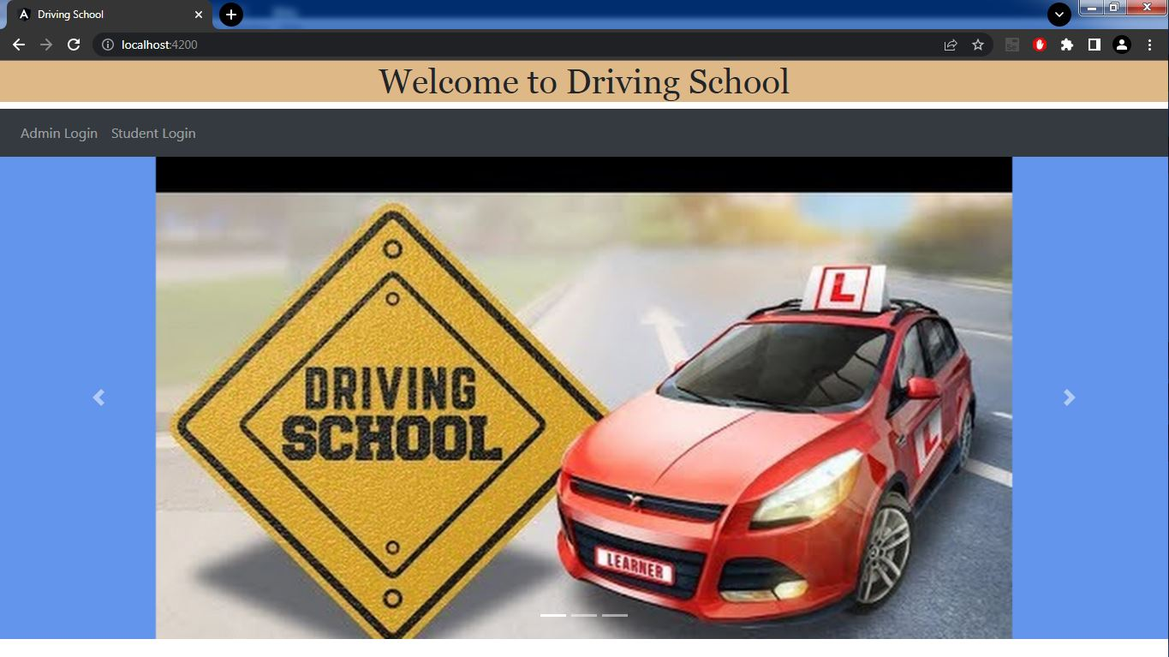
ADVANCED DRIVING SCHOOL MANAGEMENT SYSTEM
216 JAVA SL SG-RLL GROUP -1

Slide 2
Team members
FRONTEND TEAM
BACKEND TEAM
EMPLOYEE ID | NAME
2492655 | Anurag Pal (TEAM LEAD) (FRONTEND-LEAD)
2492672 | Bachu Venkata Samyuktha
2492554 | Ashritha P
2491065 | Bablu Prasad
2491105 | Biswabhusan Dash
EMPLOYEE ID | NAME
2490919 | Akanksha Bhanudas Ligade
2490993 | Arun Pratap Singh
2490174 | Bejugam Naveen Kumar (BACKEND-LEAD)
2490113 | Ashwin Lakhan Mathankar
2491473 | Bommana Deviprasad

Slide 3
Index
Introduction
Project Scope
Tools and Technologies.
Architecture
Entities
Controllers
Services
PostMan Functional Testing
Frontend Outputs

Slide 4
Introduction
This Advanced Driving School Management system can reduce the efforts of human power.
It ensures driving-training school’s information resource to be utilized effectively.
Admin is having control over all modules of the system.
Each student is provided by a unique user id and password. They can login in to the driving school management system with the id and password.
It is a Web-based application and it is a user-friendly.

Slide 5
Project scope
To develop a system that will allow driving schools electronically record student’s information.
The system will serve as a repository of the student’s record enrolled for driving lesson.
The system will ease up scheduling student’s driving lesson.
The system is easy, efficient and reliable to use.

Slide 6



Tools and technologies
Front-End : Angular
Server-Side : Spring-Boot.
Back-End : MYSQL, Hibernate.
Server : Tomcat-9.0

Slide 7
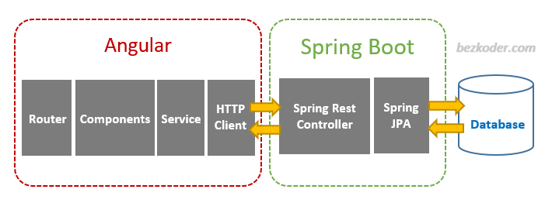
Project architecture

Slide 8
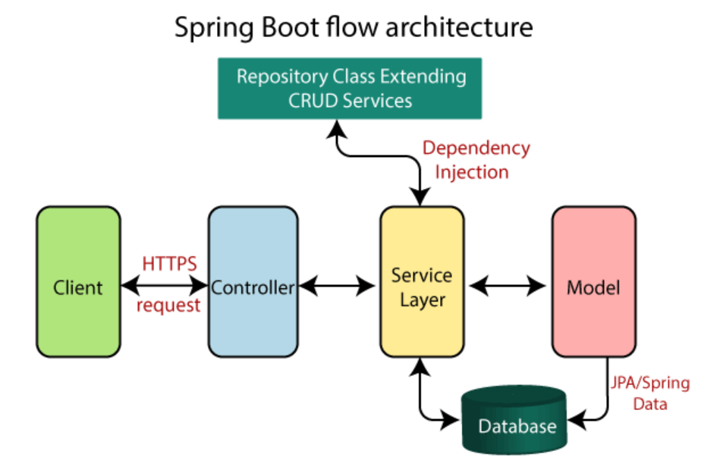

Slide 9
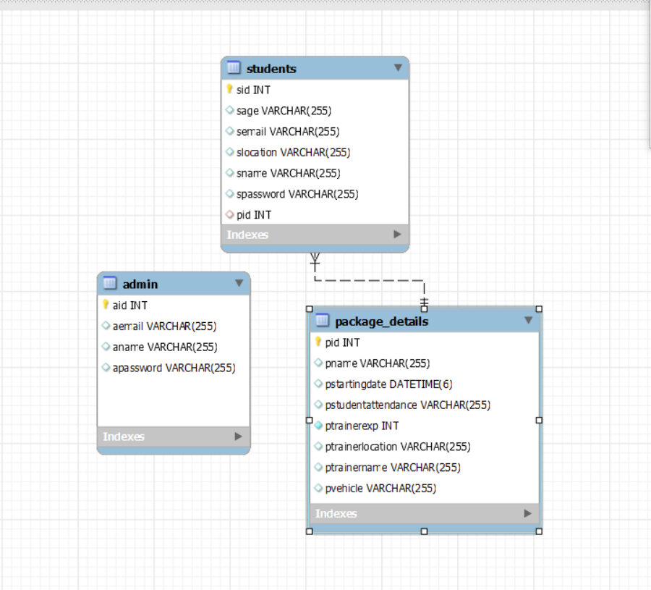
Database Schema:

Slide 10
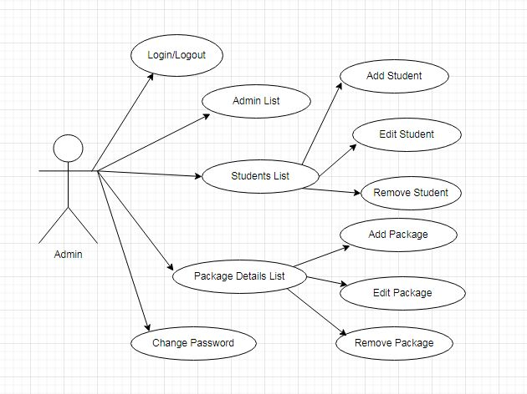
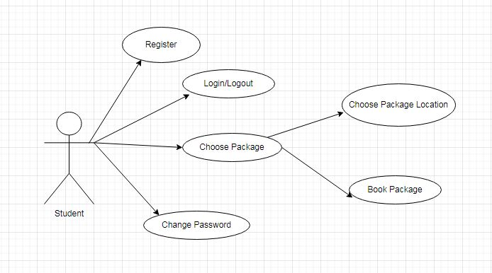
Use-case diagrams:

Slide 11
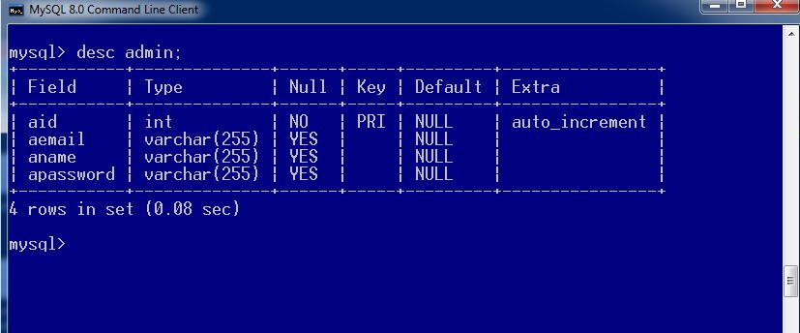
Admin-entity
The fields of Admin-Entity are
Admin-Id (aid)
Admin-Name (aname)
Admin-Email (aemail)
Admin-Password (apassword)

Slide 12
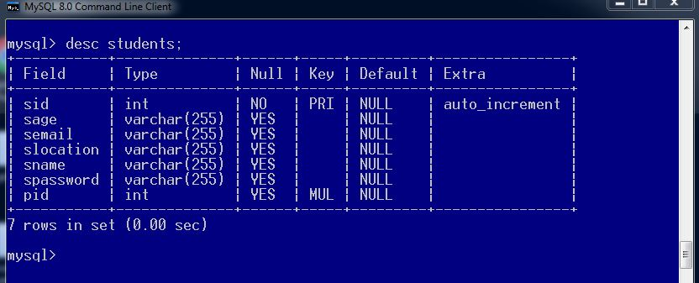
Students entity
The fields of Students-Entity are
Student-Id (sid)
Student-Name (sname)
Student-Age (sage)
Student-Email (semail)
Student-Password (spassword)
Student-Location (slocation)

Slide 13
Package-details-entity
The fields of Package-details entity are
Package-Id (pid)
Package-Name (pname)
Package-Starting Date (pstartingdate)
Package-Student-Attendance (pstudentattendance)
Package-Vehicle (pvehicle)
Package-Trainer-Name (ptrainername)
Package-Trainer -Location (ptrainerlocation)
Package-Trainer-Experience (ptrainerexp)

Slide 14
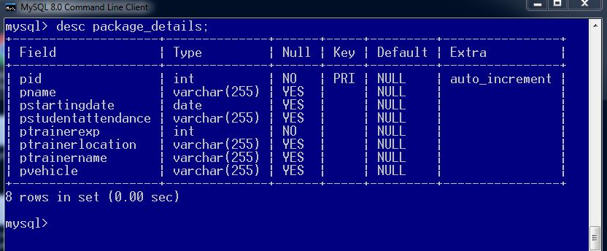

Slide 15
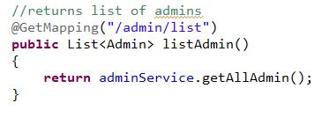
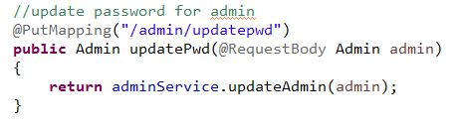
Admin-Controller
@Get Mapping (list)--------- For list of Admins
@Put Mapping (updatepwd)-------To change Password

Slide 16
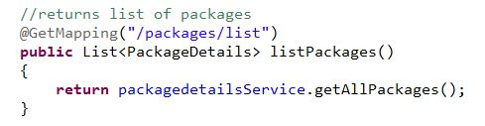
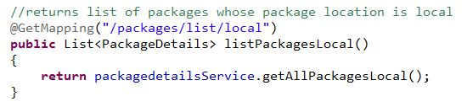
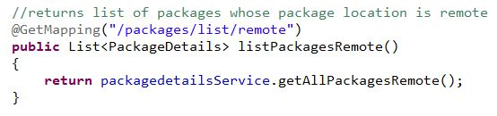
PackageDetails-Controller
Mappings involved are
@Get Mapping(list) ------ List of Packages

Slide 17
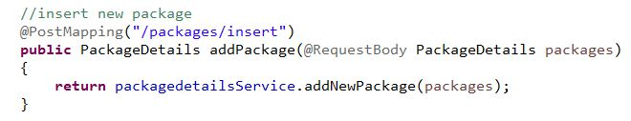
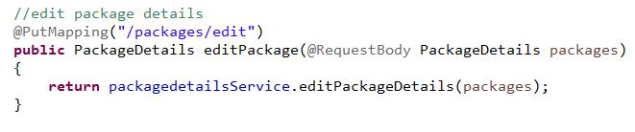
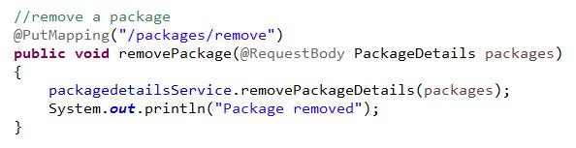
@Post Mapping (insert) ---- To Add a New Package
@Put Mapping(edit) -------- Changes to the existing Package
@Put Mapping (remove) ------ To remove the existing Package

Slide 18
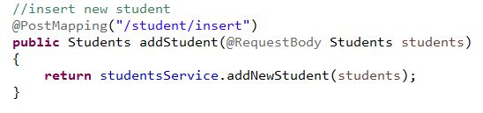
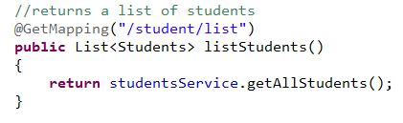
Students-Controller
Mappings involved are
@Post Mapping(insert) ---- To add a New Student
@Get Mapping (list) --- To get list of Students

Slide 19
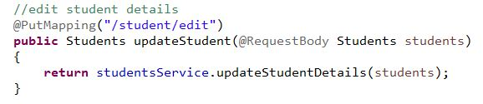
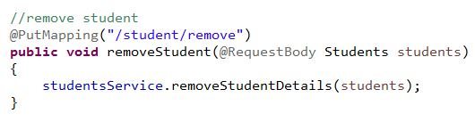
@Put Mapping (edit)----- To change the Student Details
@Put Mapping (remove) ----- To remove the Student

Slide 20
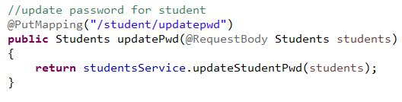
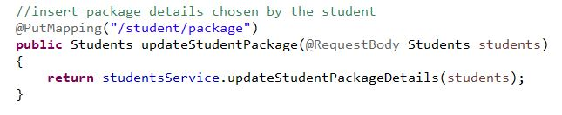
@Put Mapping (updatepwd) --- To Update Password
@Put Mapping (package) ---- To Update Package Details

Slide 21
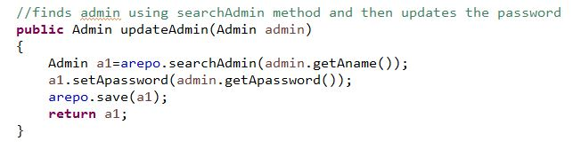
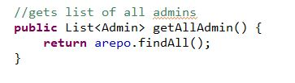
Admin-Service
The services involved are
Update Admin
List of Admins

Slide 22
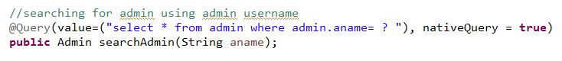
ADMIN REPO

Slide 23
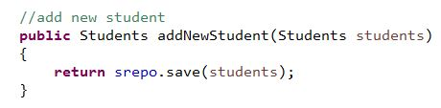
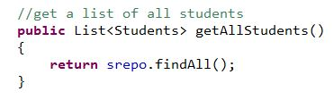
Students-Service
The Services involved are
Add a New Student
List of Students

Slide 24
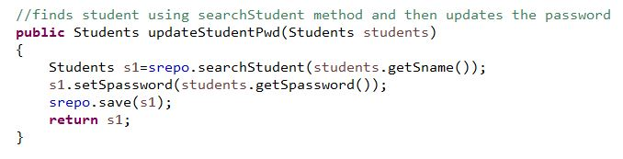
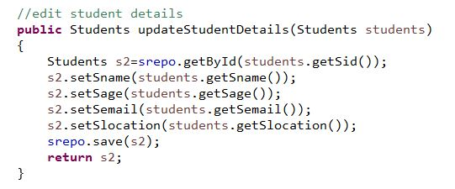
Update Password
Update existing Student Records

Slide 25
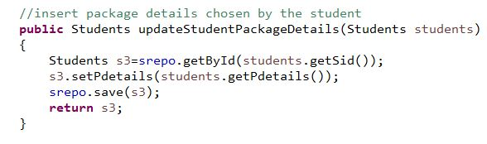
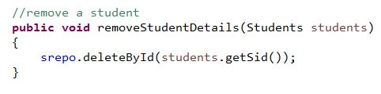
Update Package details
Remove the student

Slide 26
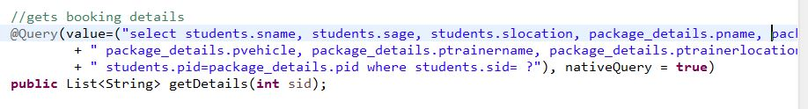
Student Repo

Slide 27
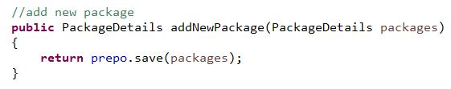
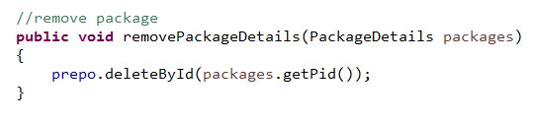
Package Details-Service
The Services Involved are
Add a New Package
Remove Package

Slide 28
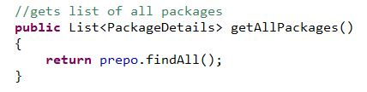
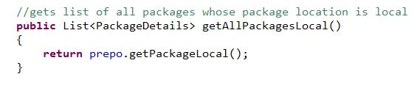
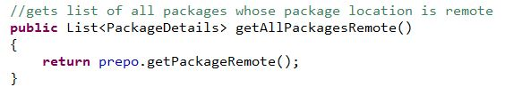
List of Packages

Slide 29
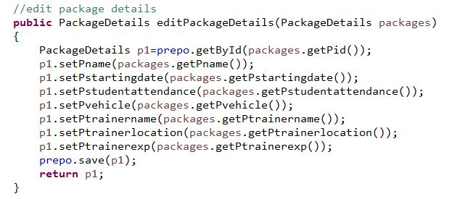
Edit Package Details

Slide 30
Package Details Repo

Slide 31
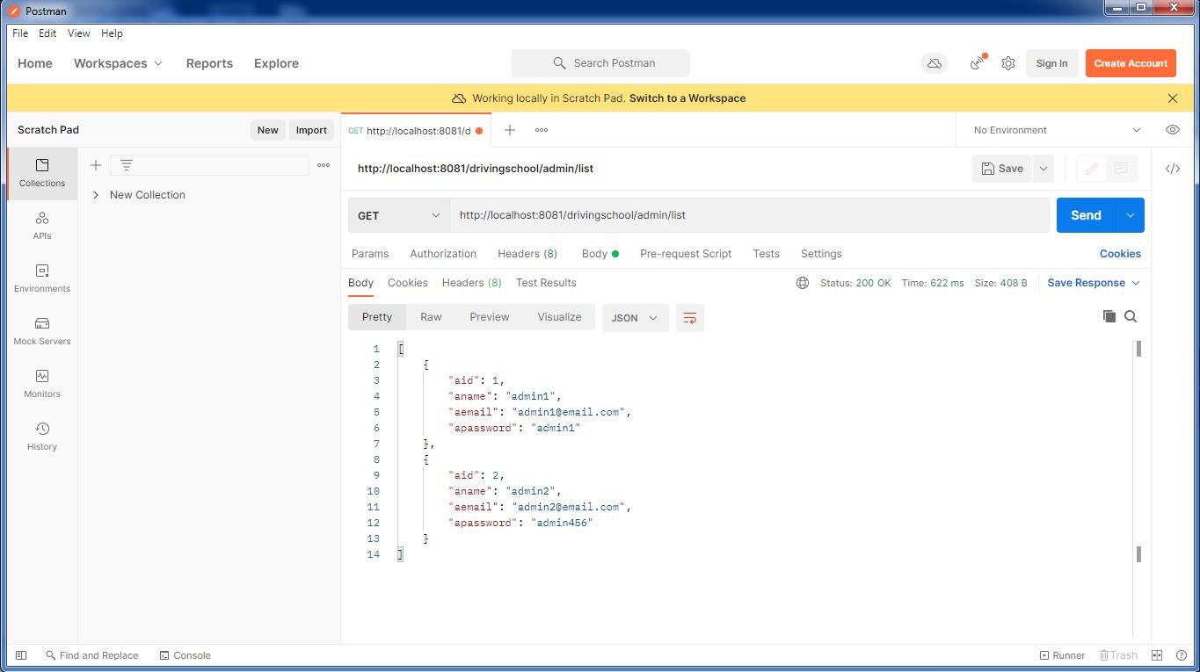
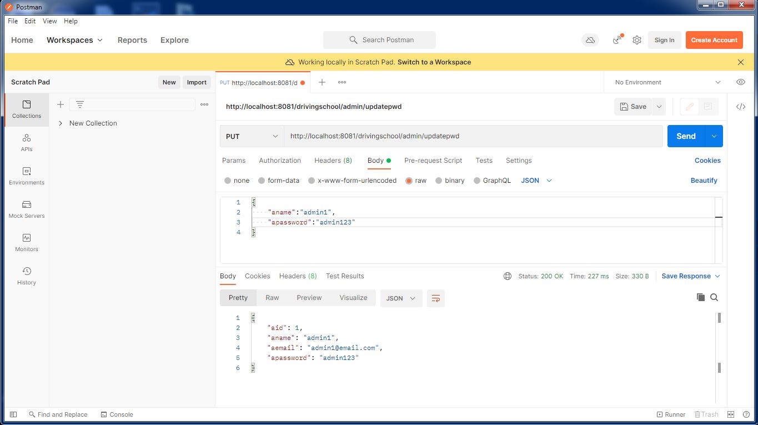
POSTMAN FUNCTIONAL TESTING FOR ADMIN

Slide 32
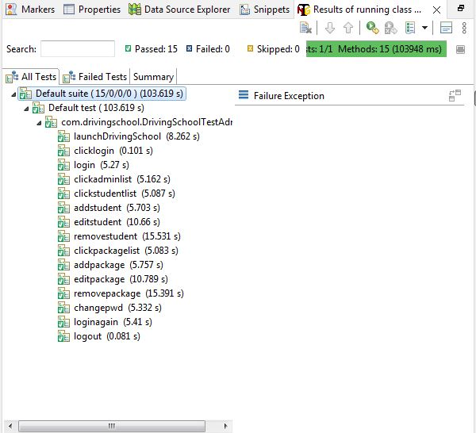
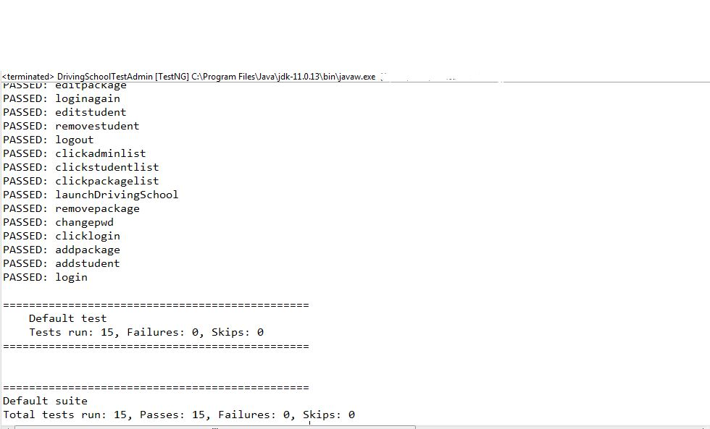
Admin TestNG Snapshots

Slide 33
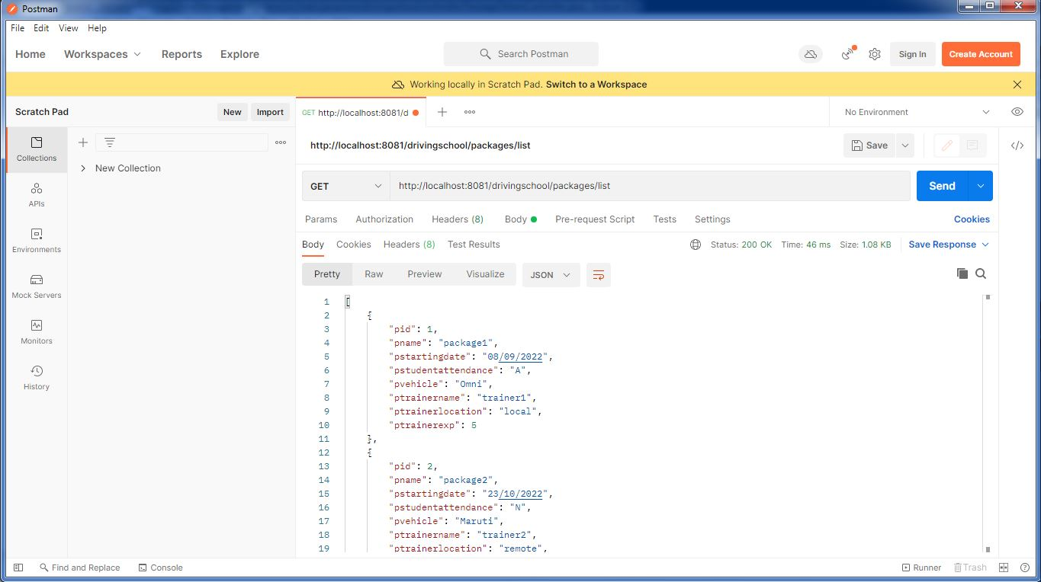
POSTMAN FUNCTIONAL TESTING FOR PACKAGE DETAILS

Slide 34
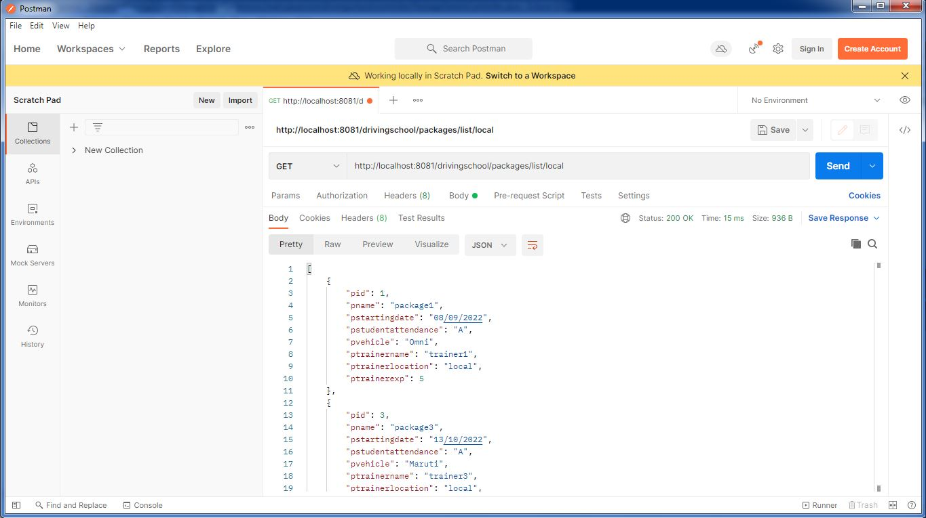

Slide 35
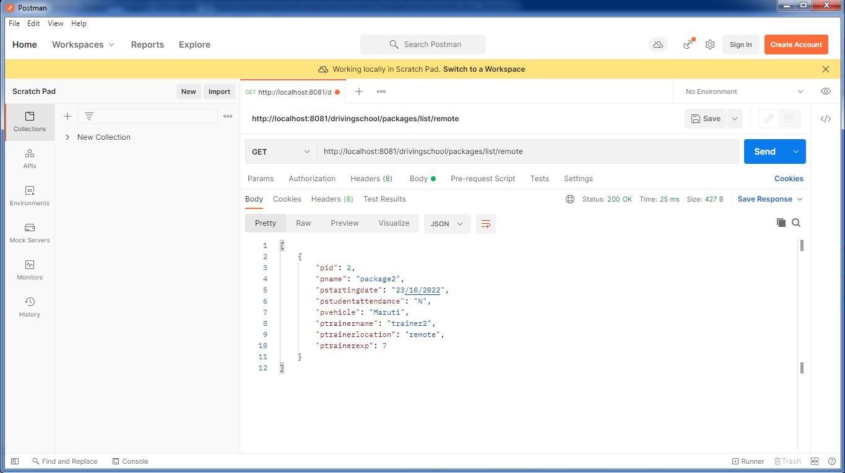

Slide 36
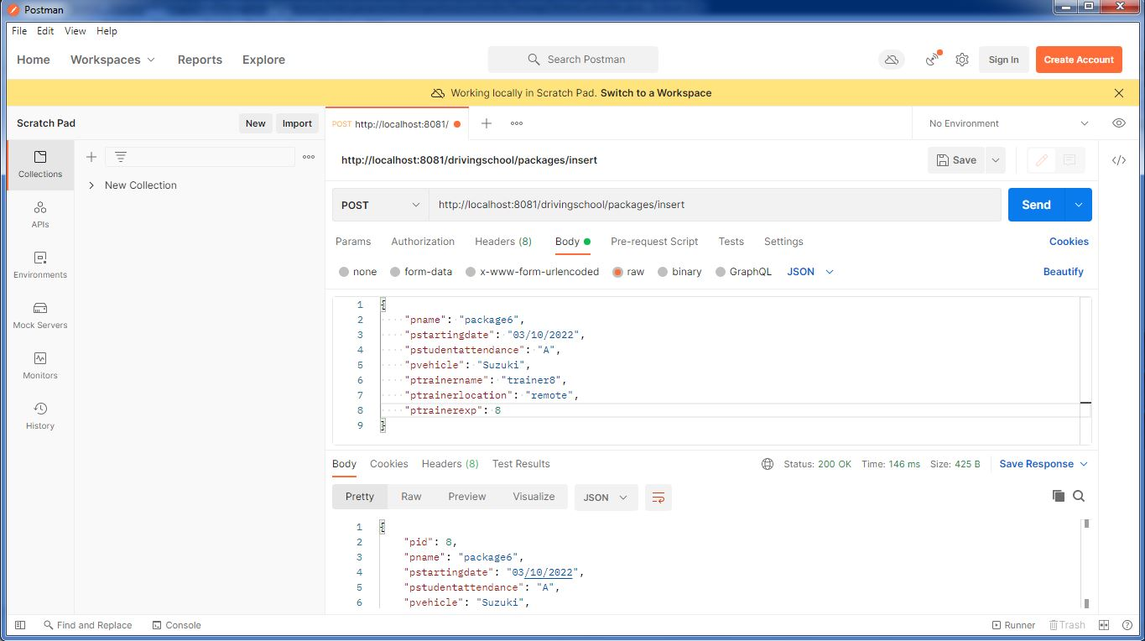

Slide 37
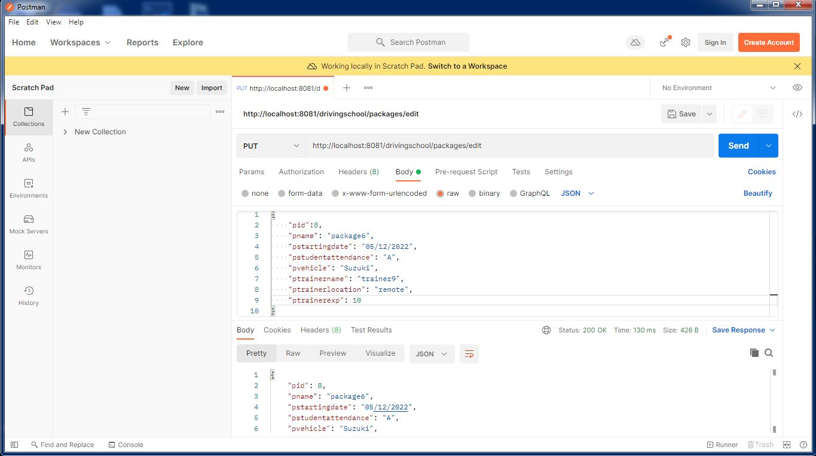

Slide 38
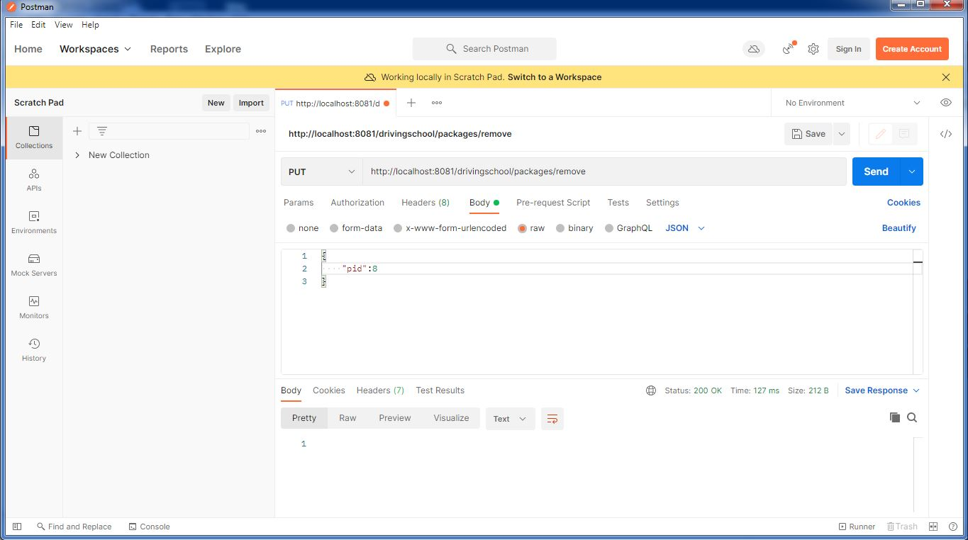

Slide 39
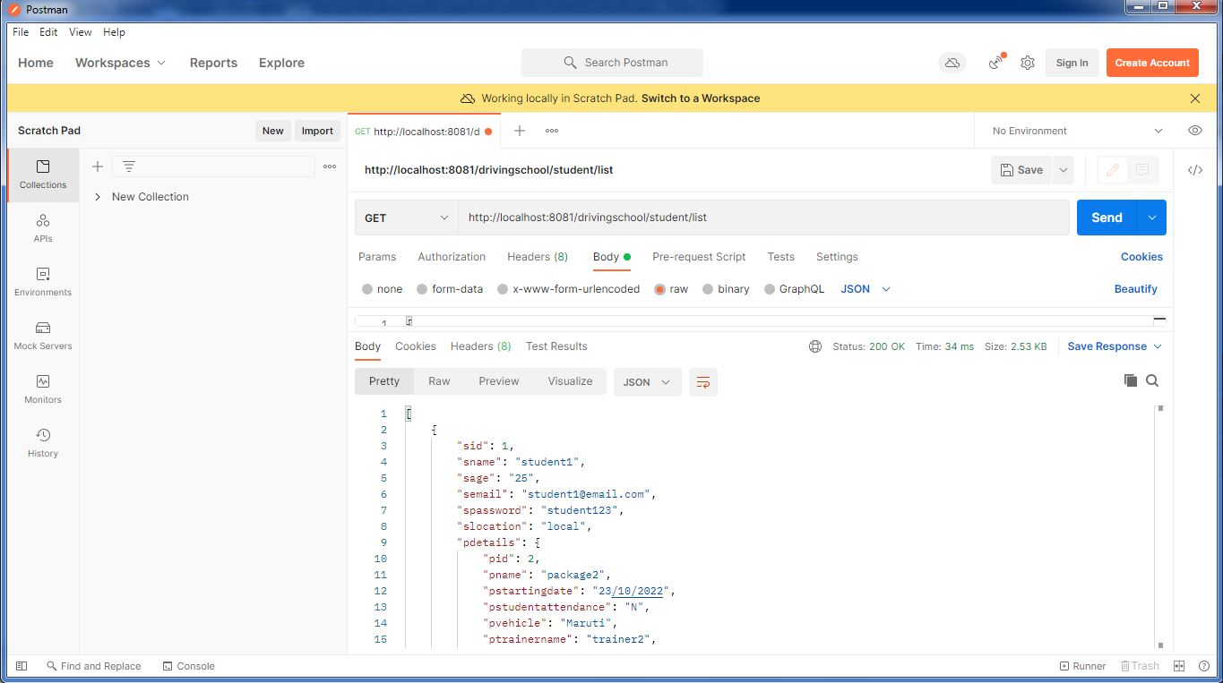
POSTMAN FUNCTIONAL TESTING FOR STUDENT

Slide 40


Slide 41


Slide 42


Slide 43


Slide 44


Slide 45


Student TestNg Outputs

Slide 46

Frontend outputs

Slide 47



Slide 48



Slide 49



Slide 50



Slide 51



Slide 52



Slide 53



Slide 54



Slide 55



Slide 56



Slide 57



Slide 58


